Slide 1
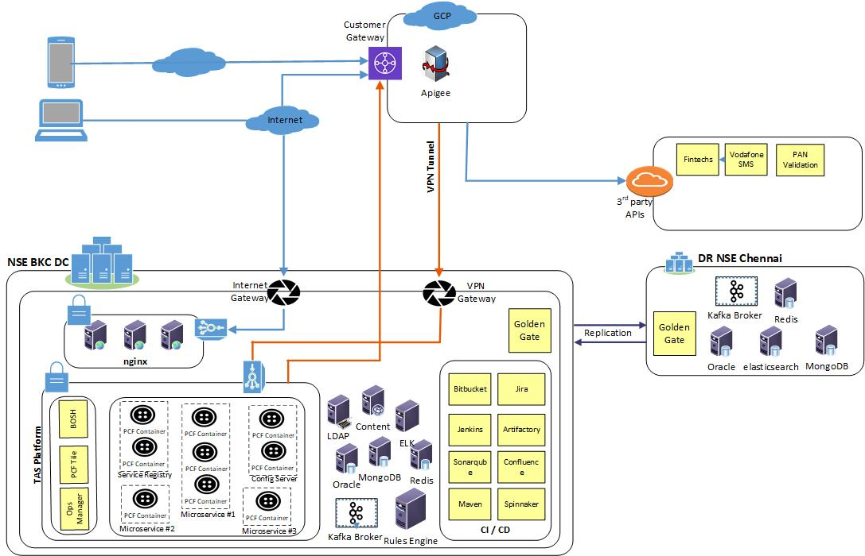
Deployment View High Level

Slide 2





Deployment View Detailed
Kohinoor - Development
Application Environment
NSX Manager Cluster
vCenter Server Appliance
Tanzu Application Service foundation
CICD Tools/Data Base
TAS Control Plane
vSphere Cluster/ HA/DRS
vSphere Cluster/ HA/DRS
vSphere Cluster/ HA/DRS
Existing Mgmt. Cluster
App Production Cluster(TAS)/DB
CI-CD/DB Cluster
Persistence Layer
Kafka Broker
Policy Management
Production Site - DC
Oracle
Mongo
Redis Cache
Elastic search
DR Site - Chennai
PCF Org
Persistence Layer
PCF Org
Apps
Apps
Apps
Apps
Dev Space
Dev2 Space
Oracle
Oracle
Dev Space
Dev2 Space
Diego Cell 1
Diego Cell 1
Mongo
Mongo
Diego Cell 1
Diego Cell 1
Diego Cell 2
Diego Cell 2
Redis Cache
MPLS
Redis Cache
Diego Cell 2
Diego Cell 2
Diego Cell 3
Diego Cell 3
Diego Cell 3
Diego Cell 3
Ops Manager
Diego BBS/Brain
Bosch Director
GOGS
Elastic search
Elastic search
Ops Manager
Diego BBS/Brain
Bosch Director
GOGS
Go Router
Replication
Go Router
Go Router
Cloud Controller
Go Router
Cloud Controller
Go Router
Jump Box
Concourse
Persistence Layer
Persistence Layer
Go Router
Jump Box
Concourse
Control Engine- VMs
CE Automation- VMs
CE Automation- VMs
Compute Engine - VMs
Control Engine- VMs
Compute Engine - VMs
AD, DNS, DHCP
Kafka Broker
Kafka Broker
AD, DNS, DHCP
VMware vCenter Server
VMware NSX Manager/ NSX Controller
Internet
VMware vCenter Server
VMware NSX Manager/ NSX Controller
ESXi Cluster
TAS on VMs Foundation- Production
ESXi Cluster
Policy Management
Policy Management
TAS on VMs Foundation- DR

